Slide 1

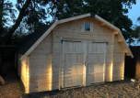

A ‘SHED’ FOR
WICKHAM MARKET?

Slide 2
A ‘SHED’ FOR
WICKHAM MARKET?
The Men’s Sheds concept came about through a lack of social opportunities for retired men and those who find themselves in isolation.
They are about having fun, sharing practical skills and knowledge with like-minded people and gaining a renewed sense of purpose and belonging.
As a by-product of all of that they reduce isolation and feelings of loneliness, and they allow people to deal with mental health challenges more easily whilst they remain independent.

Slide 3
A ‘SHED’ FOR
WICKHAM MARKET?
        Wickham Market Partnership approached the local Ambassador for the UK Men’s Sheds Association, Doug Mizon, to determine the need in this area.
As a result of this an introductory presentation to the community was advertised, and took place on 13thJanuary 2020.
This was well received with 16 attendees, who agreed they wanted to take this idea forward.

Slide 4
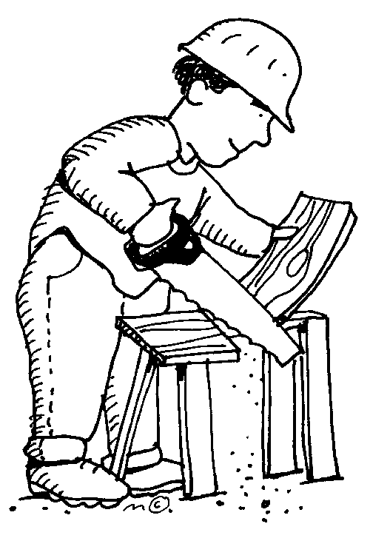
A ‘SHED’ FOR
WICKHAM MARKET?
Informal fortnightly meetings ensued, where discussions centred around possible locations for a Shed, what could be achieved, and what skills could be shared.
Members came to meetings with researched ideas and suggestions
Various locations in and around Wickham Market were investigated

Slide 5
A ‘SHED’ FOR
WICKHAM MARKET?
Visits to three local Sheds were also arranged:
Saxmundham :a very small building behind the Council offices, formerly a police dog unit
Debenham : a 40 x 8ft converted container housing power tools, work stations & a refreshment area, plus access to a nearby barn (part of a Community Farm)
Halesworth: a large former industrial unit with a wide range of tools, which is rented. Work carried out & subscriptions fund this

Slide 6
A ‘SHED’ FOR
WICKHAM MARKET?
The visits to other Sheds informed the group members of what they would like to aspire to:
A medium sized unit that could house table/bench woodworking & metalworking tools as well as smaller hand tools
Be central to Wickham Market to allow accessibility for the whole community
Access to outside space for socialising with refreshments and for bigger projects

Slide 7
A ‘SHED’ FOR
WICKHAM MARKET?
The Glebe allotment site was the most favoured option due to its central location and accessibility by foot and by car.
It could potentially offer benefits for existing allotment tenants through the provision of a shared toilet facility
A suitable wooden structure could be constructed on a hard-standing
Power, water and foul drainage available nearby

Slide 8
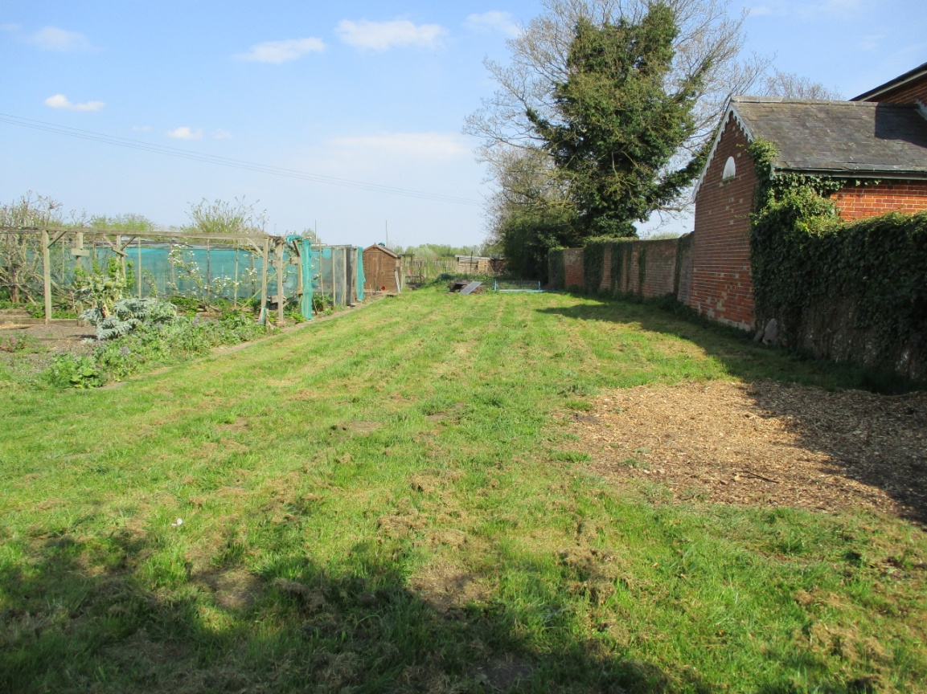
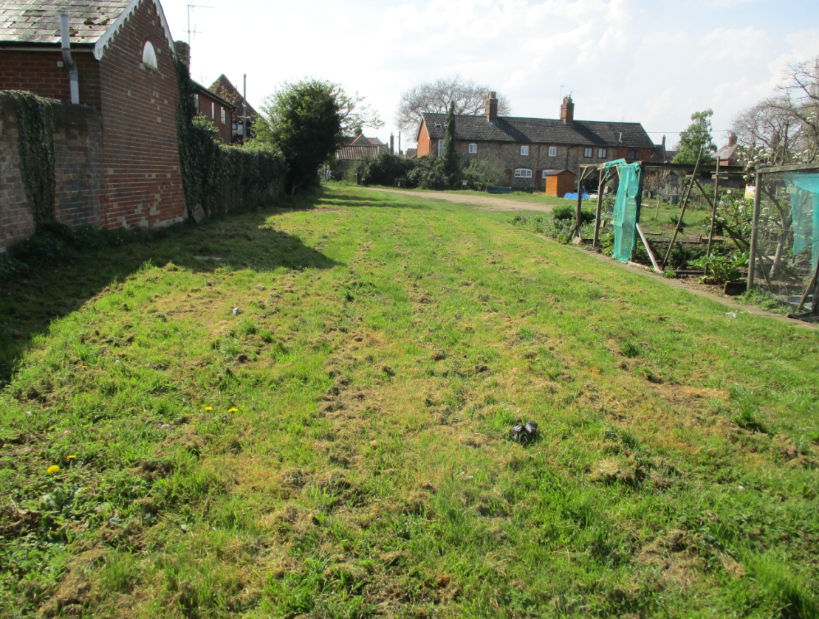
A ‘SHED’ FOR
WICKHAM MARKET?
Taken from SW of site looking east. Beehive building on right
Taken from east looking west towards Wickham Market centre. Beehive building on left with wall linking to vicarage. Entrance to site in far left corner (SW corner of site)

Slide 9
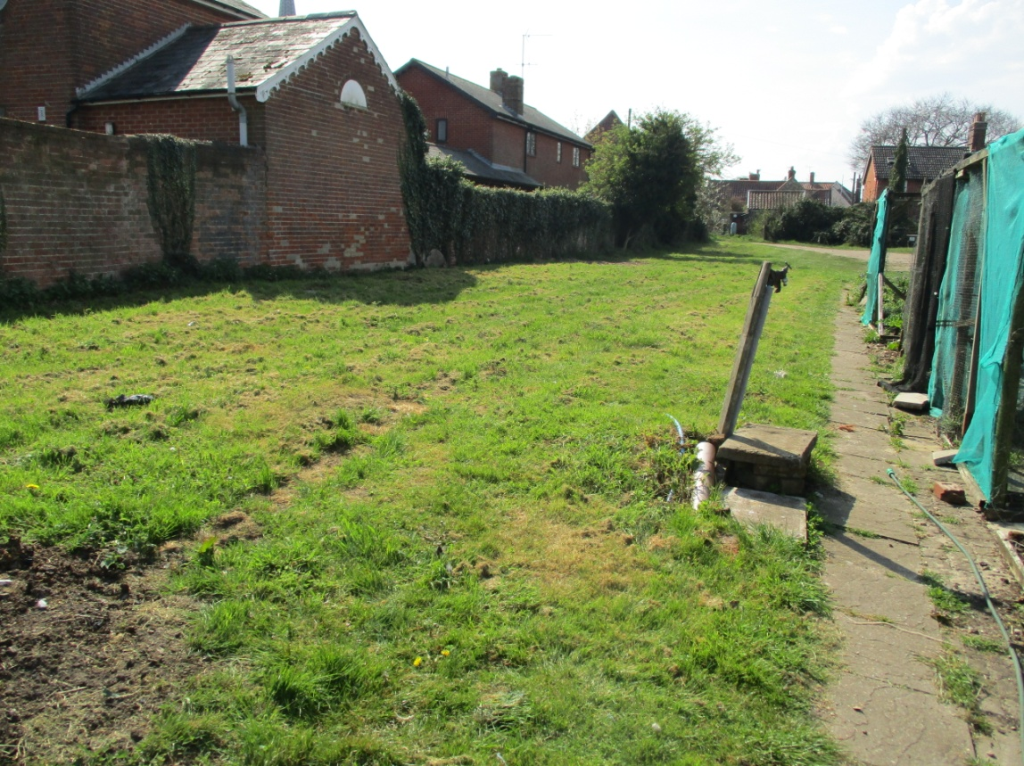
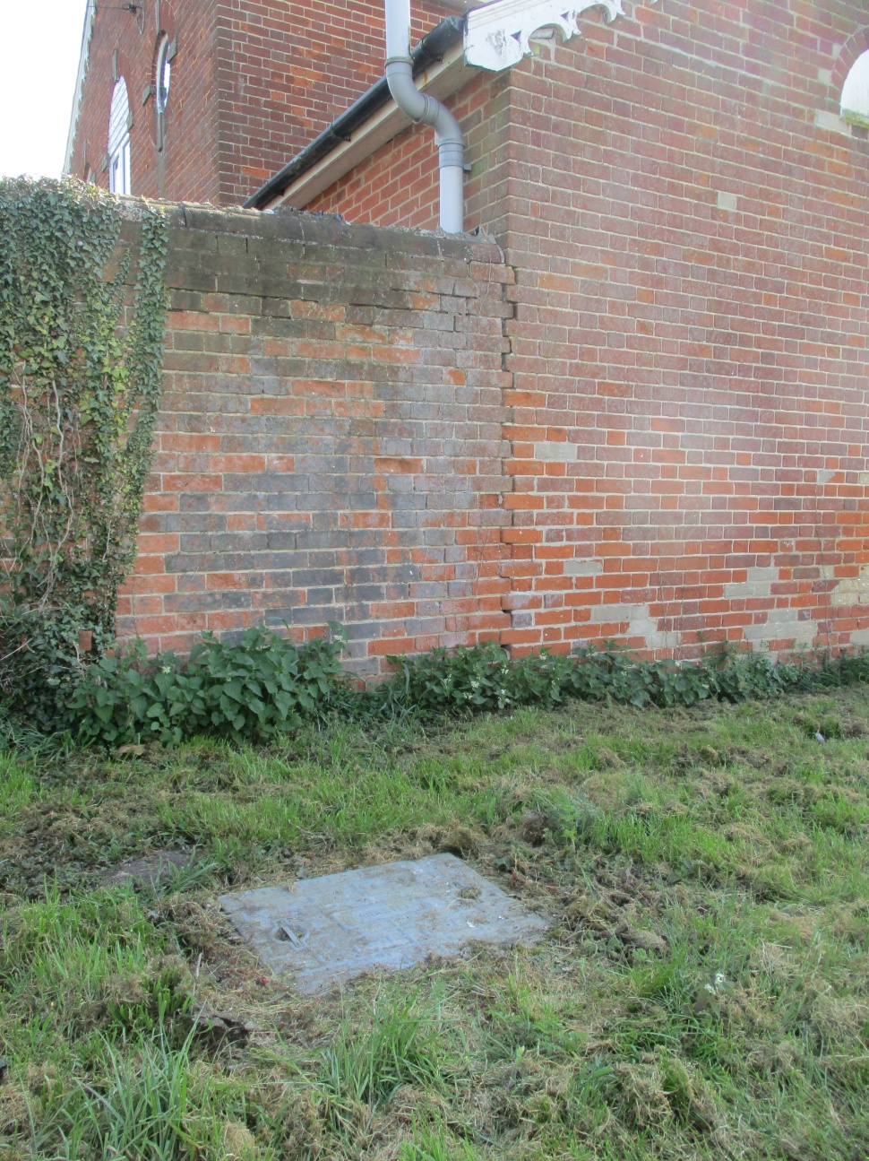
A ‘SHED’ FOR
WICKHAM MARKET?
East to west, showing water supply
Close up view of manhole situated adjacent to Beehive building on west of site

Slide 10
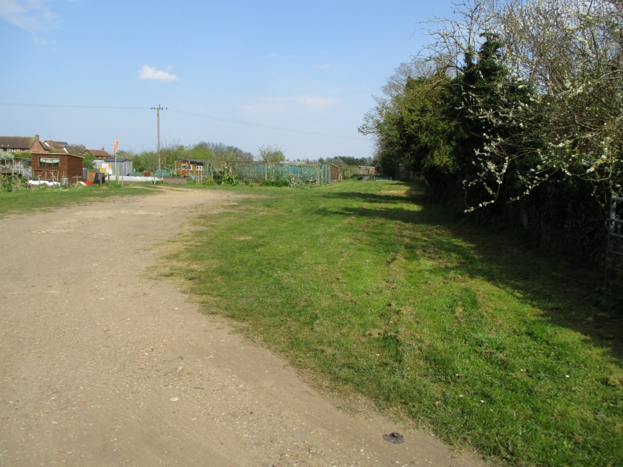
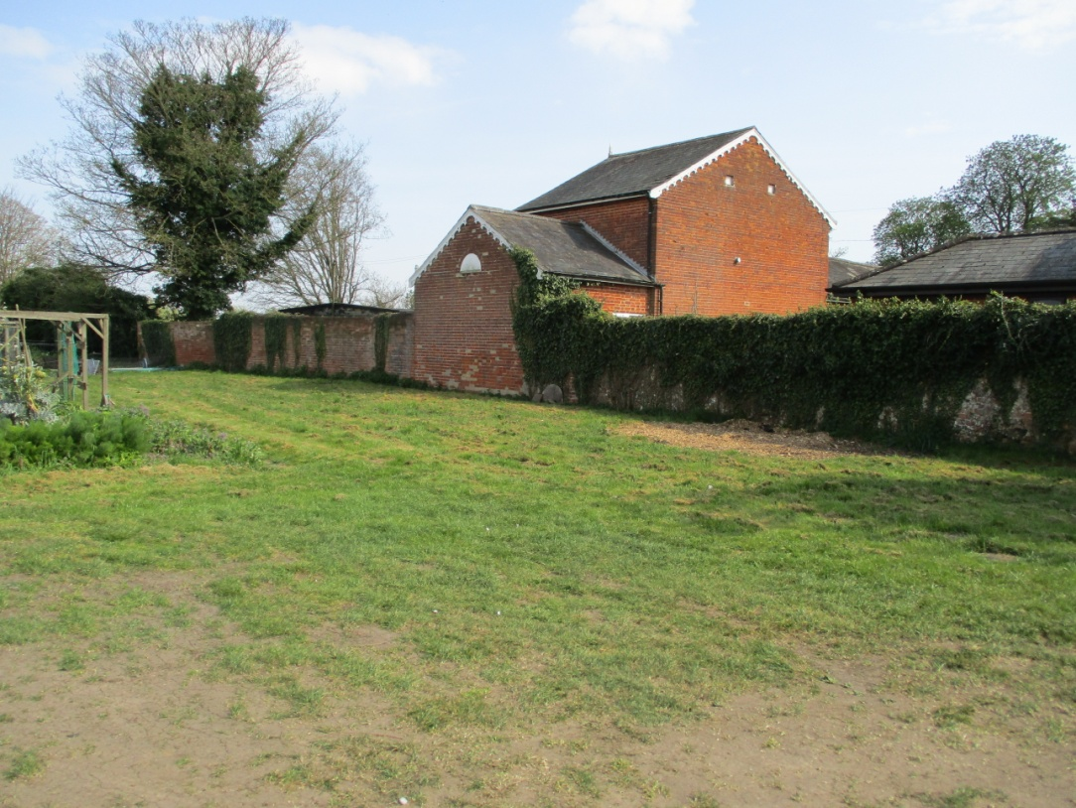
A ‘SHED’ FOR
WICKHAM MARKET?
Entrance to site situated in SW corner
View of Beehive building in the centre with connecting wall to vicarage (modern garage behind wall)

Slide 11
A ‘SHED’ FOR
WICKHAM MARKET?
Wooden garage-style unit offers low impact roof profile, double doors for easy access for materials, storage space each side, opportunity to install refreshment area to one end & toilet cubicle that could be accessed from outside. 9m x 6m

Slide 12
A ‘SHED’ FOR
WICKHAM MARKET?
Help & Support
UK Men’s Sheds Association
Constitution
Committee structures
Health & Safety advice
Risk assessment templates
Regular newsletters – ‘Shoulder to Shoulder’
The Partnership joined the Association in March 2020

Slide 13
A ‘SHED’ FOR
WICKHAM MARKET?
How much could it cost?
Groundworks for concrete hardstanding: £4k + VAT
Connection to water supply:
Connection to foul water drainage:
Connection to electrical supply:
Wooden barn structure:
£7,450 + VAT
Installation of toilet facilities & sink
Installation of kitchenette
Sundry kitchen items

Slide 14
A ‘SHED’ FOR
WICKHAM MARKET?
POTENTIAL FUNDING SOURCES
Awards for All (National lottery)
- up to £10,000
Adnams Community Trust
- £100 to £2,500
Co-operative Local Community Fund
East Suffolk District Council:
- Enabling Communities fund (up to £7,500)
- Community Forums (up to £10,000)
Wickham Market Partnership

Slide 15
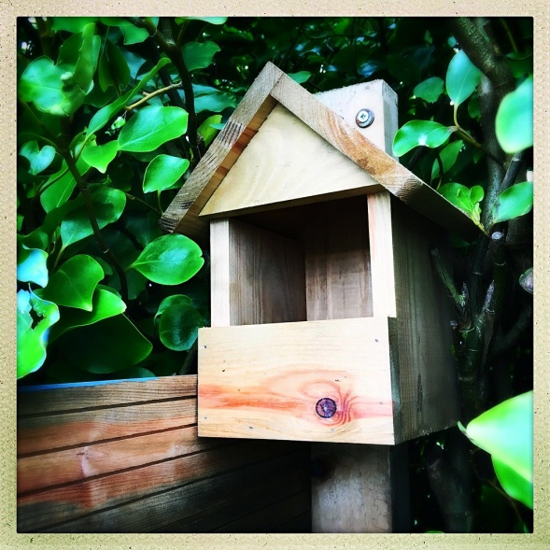
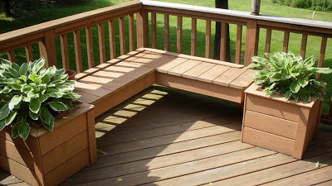
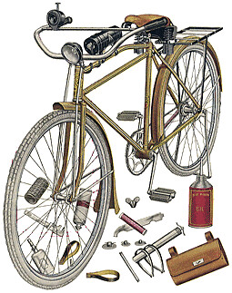
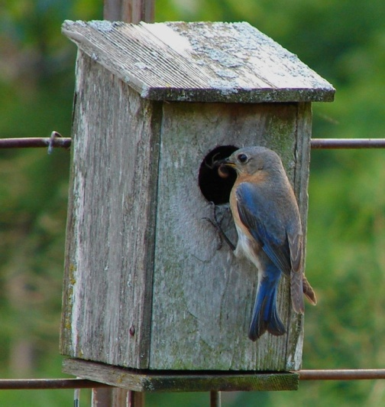
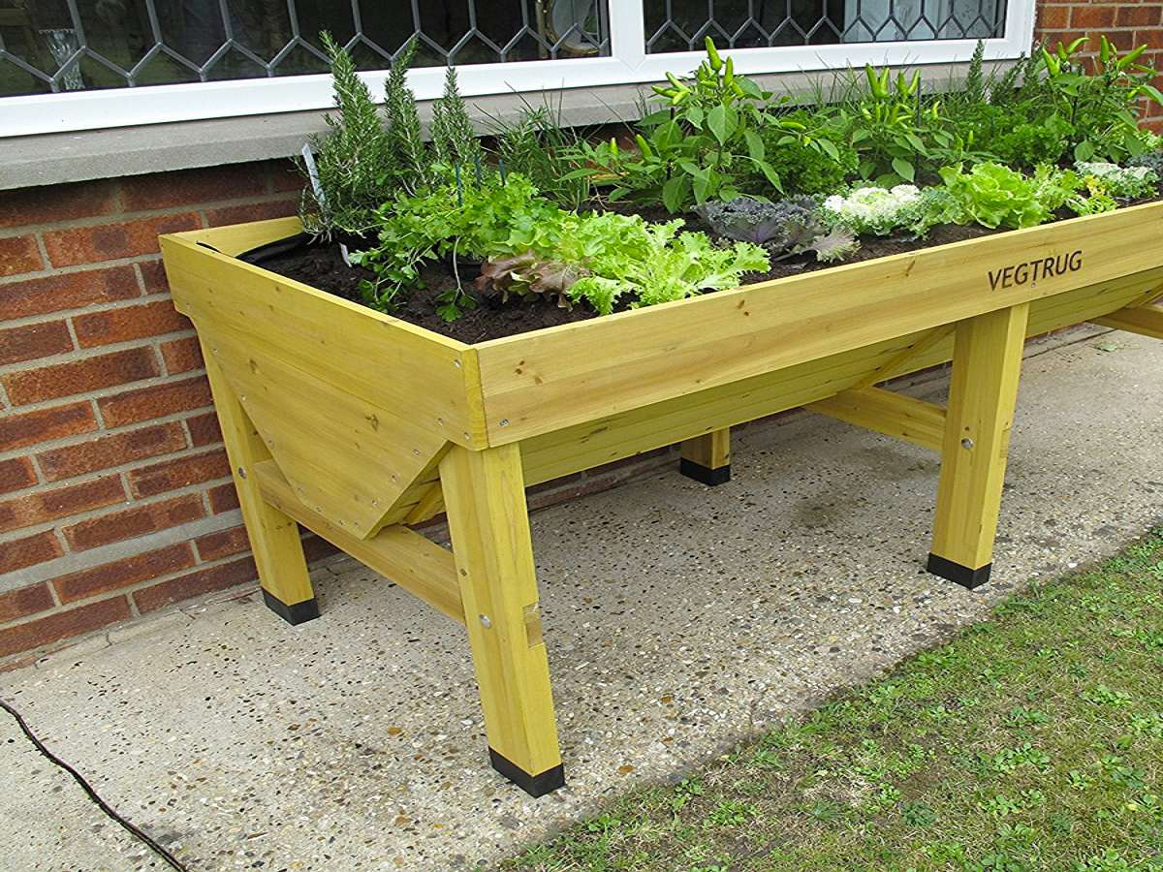
A ‘SHED’ FOR
WICKHAM MARKET?
What might be made or activities carried out

